Slide 1
Pandas (Python Module) Seyyed Ali Shohadaalhosseini

Slide 2
Introduction
What is Pandas?
Pandas is a Python library used for working with data sets.
It has functions for analyzing, cleaning, exploring, and manipulating data.
The name "Pandas" has a reference to both "Panel Data", and "Python Data Analysis" and was created by Wes McKinney in 2008.

Slide 3
Why Use Pandas?
Pandas allows us to analyze big data and make conclusions based on statistical theories.
Pandas can clean messy data sets, and make them readable and relevant.
Relevant data is very important in data science.
Data Science: is a branch of computer science where we study how to store, use and analyze data for deriving information from it.

Slide 4
What Can Pandas Do?
Pandas gives you answers about the data. Like:
Is there a correlation between two or more columns?
What is average value?
Max value?
Min value?
Pandas are also able to delete rows that are not relevant, or contains wrong values, like empty or NULL values. This is called cleaning the data.

Slide 5
Where is the Pandas Codebase?
The source code for Pandas is located at this GitHub repository https://github.com/pandas-dev/pandas

Slide 6
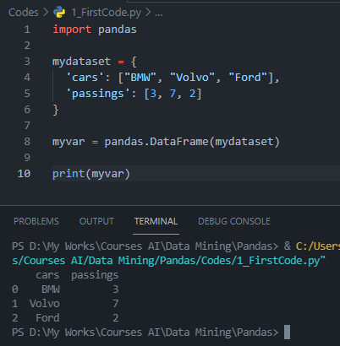

Let’s get into coding
Look at the front example:
alias: In Python alias are an alternate name for referring to the same thing.
Now the Pandas package can be referred to as pd instead of pandas.
The version string is stored under __version__ attribute, So

Slide 7
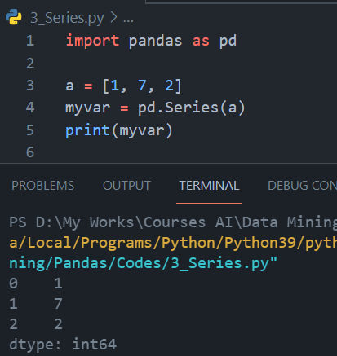
Pandas Series
What is a Series?
A Pandas Series is like a column in a table. It is a one-dimensional array holding data of any type.

Slide 8
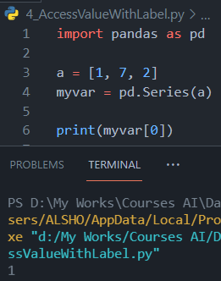
Pandas Series
Labels
If nothing else is specified, the values are labeled with their index number. First value has index 0, second value has index 1 etc. This label can be used to access a specified value.

Slide 9
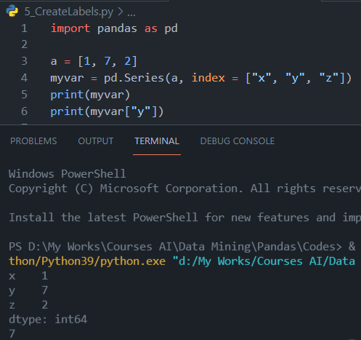
Pandas Series
Create Labels
With the index argument, you can name your own labels. When you have created labels, you can access an item by referring to the label.

Slide 10
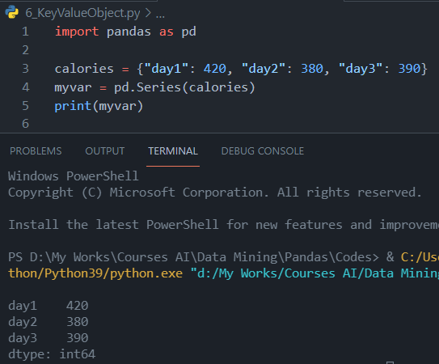
Pandas Series
Key/Value Objects as Series
You can also use a key/value object, like a dictionary, when creating a Series.
The keys of the dictionary become the labels.

Slide 11
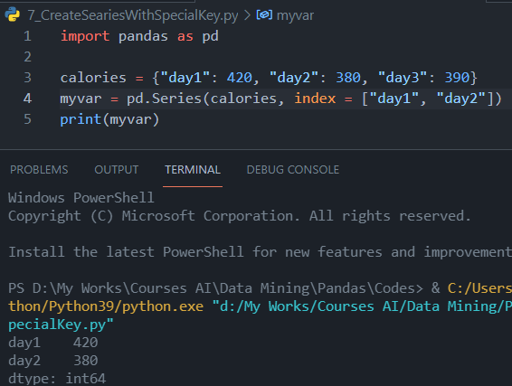
Pandas Series
Key/Value Objects as Series
To select only some of the items in the dictionary, use the index argument and specify only the items you want to include in the Series.

Slide 12
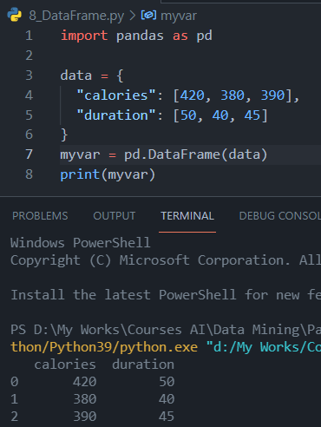
Pandas Series
DataFrames
Data sets in Pandas are usually multi-dimensional tables, called DataFrames. Series is like a column, a DataFrame is the whole table.
What is a DataFrame?
A Pandas DataFrame is a 2 dimensional data structure, like a 2 dimensional array, or a table with rows and columns.

Slide 13
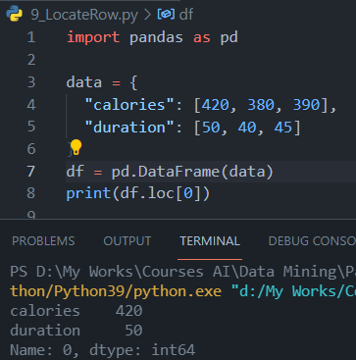
Pandas DataFrames
Locate Row
As you can see from the result above, the DataFrame is like a table with rows and columns. Pandas use the loc attribute to return one or more specified row(s).
Note: This example returns a Pandas Series.

Slide 14
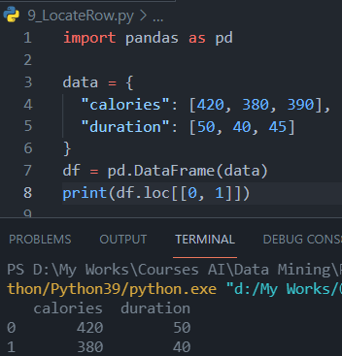
Pandas DataFrames
Note: When using [ ], the result is a Pandas DataFrame.

Slide 15
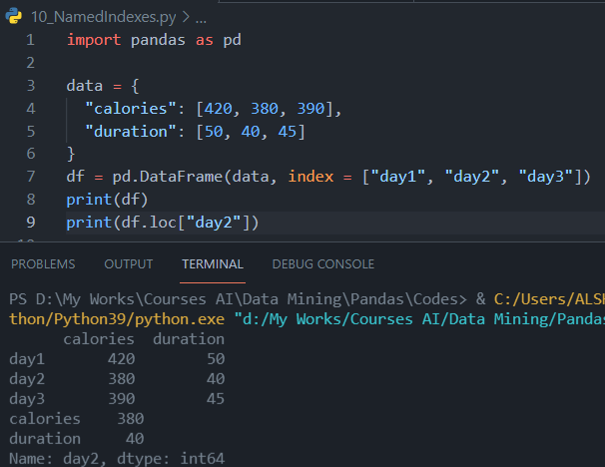
Pandas DataFrames
Named Indexes
With the index argument, you can name your own indexes.
Example
Add a list of names to give each row a name:
NOTE: Use the named index in the loc attribute to return the specified row(s).

Slide 16
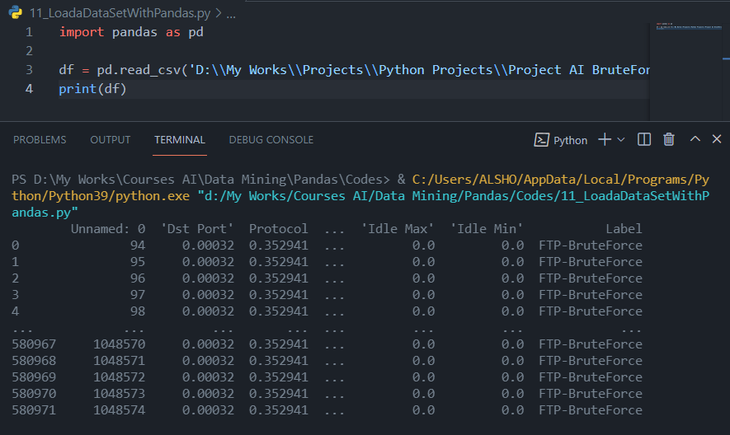
Pandas DataFrames
Load Files Into a DataFrame
If your data sets are stored in a file, Pandas can load them into a DataFrame.
Example
In our example we are importing BrutForce.csv. Load a comma separated file (CSV file) into a DataFrame:

Slide 17
https://www.w3schools.com/python/pandas/pandas_csv.asp

Slide 43
Overview
Give a brief overview of what you’ll cover in your presentation.

Slide 44
History
Make a timeline of the important historical events or list historical contributions made by people of African heritage.
1st Event | 2nd Event | 3rd Event | 4th Event | 5th Event | 6th Event
Date | Date | Date | Date | Date | Date
Description | Description | Description | Description | Description | Description

Slide 45
Interesting facts
List some interesting facts about Black History Month. Here are a few examples:
In 1926, Carter G. Woodson launched a weeklong celebration of black history in the United States.
In 1976, President Gerald Ford officially recognizes Black History Month.
Black History Month is also celebrated by Canada, Ireland, The Netherlands, and the United Kingdom.

Slide 46
Key people
Choose three leaders for Black History Month using Bing.com and discuss their lives and accomplishments. Here are some examples:
Bayard Rustin was a close advisor to Martin Luther King and an American leader of the civil rights movement. Rustin organized and led several protests, including the 1963 March on Washington.
Jesse Owens was an American track and field athlete and four-time gold medalist in the 1936 Olympic Games in Germany. Owens specialized in the sprints and the long jump.
Zora Neale Hurston was an American author, anthropologist, and filmmaker. In 1937, she published her famous novel, Their Eyes Were Watching God.

Slide 47
Arts and literature
Provide examples of art and literature that are significant to Black History Month. Here are a few examples:
The writing of James Baldwin
The music of Miles Davis
The artwork of Alma Thomas

Slide 48
How to celebrate
List some ways you can celebrate Black History Month. Here are a few examples:
Discover African American artists
Read African American authors
Listen to African American musicians
Learn important moments of African American history

Slide 49
Conclusion
Provide a brief summary of your presentation. Remind the audience what you covered in the previous slides.

Slide 50
Questions & answers
Invite questions from the audience

Slide 51
Resources
List the resources you used for your research:
Source #1
Source #2
Source #3

